Slide 1
1-toqa sameh (32) 2-rawan Mohamed (37) 3-bassant ehab (28) 4-mariam reda (76) 5-haidy walid (92) 6-nermeen ahmed (87)
Arithmetic logic unit
and operations on binary numbers

Slide 2


Agenda:
- Introduction
- ADDER
- SUBTRACTOR
- MULTIPLIER
- DIVISOR
- COMPARATOR
- XOR
- XNOR
- ONE’S COMPLEMENT
- TWO’S COMPLEMENT
- SHIFT LEFT
A

Slide 3
Introduction
An arithmetic logic unit(ALU):
is a major component of the central processing unit of the a computer system. It does all processes related to arithmetic and logic operations that need to be done on instruction words. In some microprocessor architectures, the ALU is divided into the arithmetic unit (AU) and the logic unit (LU).
It can execute all arithmetic and logic operations, including Boolean comparisons, such as subtraction, addition, and shifting (XOR, OR, AND, and NOT operations). Binary numbers can also perform bitwise and mathematical operations. AU (arithmetic unit) and LU (logic unit) are two types of arithmetic logic units. The ALU’s operands and code instruct it on which operations to perform based on the incoming data. When the ALU has finished processing the data, it sends the result to the computer memory.

Slide 4
Operations Performed by ALU :
- Arithmetic operations :
This refers to bit addition and subtraction.
Although multiplication and division are sometimes used, these operations are more expensive to make.
Multiplication and subtraction can also be done by repetitive additions and subtractions respectively.
-logical operations:
These include operations like AND, OR, NOT, XOR, NOR, NAND, etc.
Bit-Shifting Operations − This pertains to shifting the positions of the bits by a certain number of places either towards the right or left, which is considered a multiplication or division operations.

Slide 5
Adder-subtractor
Rawan mohamed

Slide 6
4-bit binary Adder-Subtractor:
- the first full adder has a control line directly as its input(input,carry Cin), The input A0 (The least significant bit of A) is directly input in the full adder. The third input is the xor of B0 and selection bit. The two outputs produced are Sum/Difference (S0) and Carry (C0).
- If the value of selection bit (Control line) is 1, the output of B0(xor) selection bit =B0′ (Complement B0). Thus the operation would be A+(B0′).
-Now 2’s complement subtraction for two numbers A and B is given by A+B’+Cin.
This suggests that when selection bit =1, the operation being performed on the four-bit numbers is subtraction.
-Similarly If the Value of selection bit =0, B0 (xor) K=B0. The operation is A+B which is simple binary addition.
-This suggests that When selection bit =0, the operation is performed on the four-bit numbers in addition. Then C0 is serially passed to the second full adder as one of it’s inputs.

Slide 7
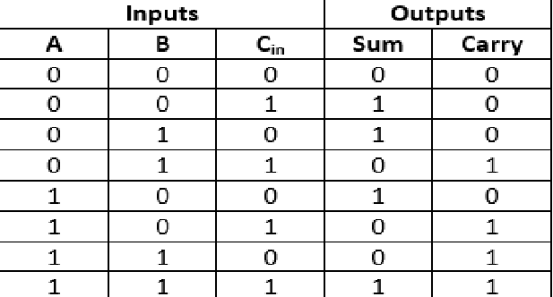
- Then C0 is serially passed to the second full adder as one of it’s inputs.
The sum/difference S0 is recorded as the least significant bit of the sum/difference. A1, A2, A3 are direct inputs to the second, third and fourth full adders.
Then the third input is the B1, B2, B3 XOR with selection bit to the second, third and fourth full adder respectively. The carry C1, C2 are serially passed to the successive full adder as one of the inputs. C3 becomes the total carry to the sum/difference. S1, S2, S3 are recorded to form the result with S0. For an n-bit binary adder-subtractor, we use n number of full adders.
-Truth table:

Slide 8
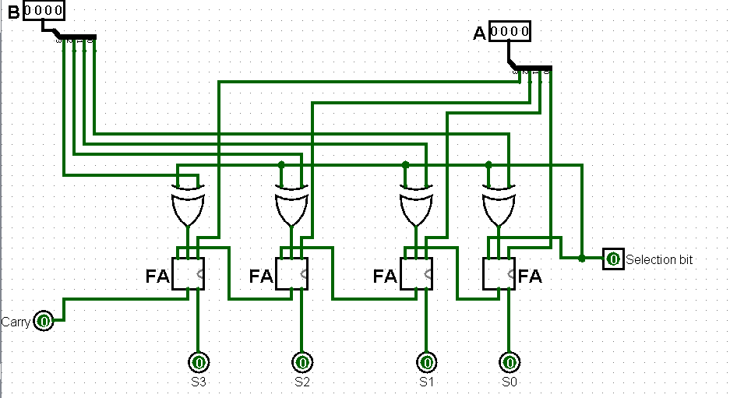
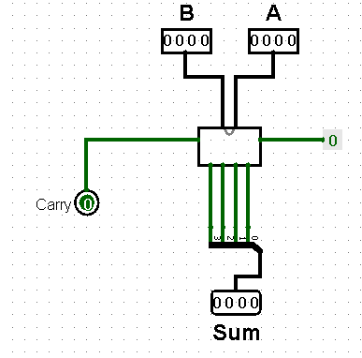
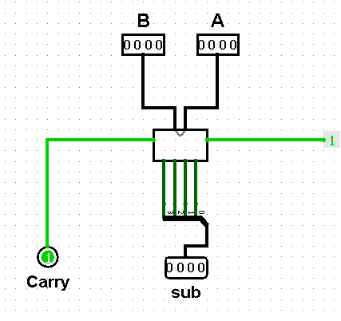
Circuit design

Slide 9
Comparator
Nermeen ahmed

Slide 10
4-Bit Magnitude Comparator
A comparator used to compare two binary numbers each of four bits is called a 4-bit magnitude comparator. It consists of eight inputs each for two four-bit numbers and three outputs to generate less than, equal to, and greater than between two binary numbers. In a 4-bit comparator, the condition of A>B can be possible in the following four cases. • If A3 = 1 and B3 = 0 • If A3 = B3 and A2 = 1 and B2 = 0 • If A3 = B3, A2 = B2 and A1 = 1 and B1 = 0 • If A3 = B3, A2 = B2, A1 = B1 and A0 = 1 and B0 = 0 Similarly, the condition for A<B can be possible in the following four cases. • If A3 = 0 and B3 = 1 • If A3 = B3 and A2 = 0 and B2 = 1 • If A3 = B3, A2 = B2 and A1 = 0 and B1 = 1 • If A3 = B3, A2 = B2, A1 = B1 and A0 = 0 and B0 = 1 The condition of A=B is possible only when all the individual bits of one number exactly coincide with the corresponding bits of another number.

Slide 11
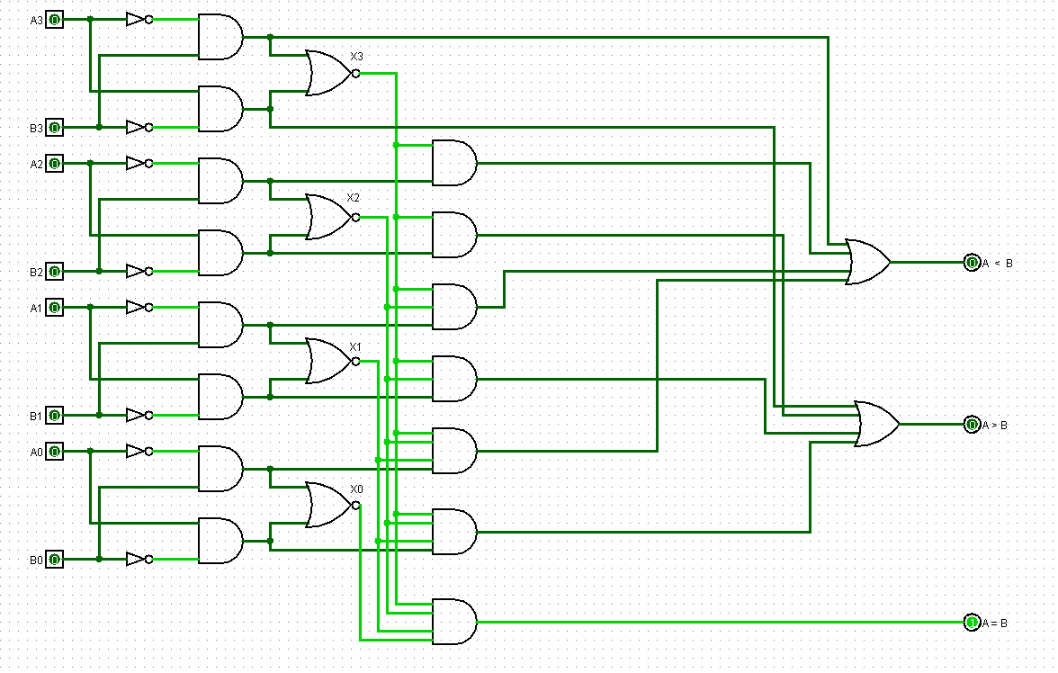
Circuit design

Slide 12
One’s and two’s complement
Toqa sameh

Slide 13
1’s complements Circuit: 1’s complement of a binary number is another binary number obtained by toggling all bits in it . transforming the 0 bit to 1 and the 1 bit to 0 . In the 1’s complement format , the positive numbers remain unchanged . The negative numbers are obtained by taking the 1’s complement of positive counterparts. 1's complement of "0111" is "1000" 1's complement of "1100" is "0011"

Slide 14
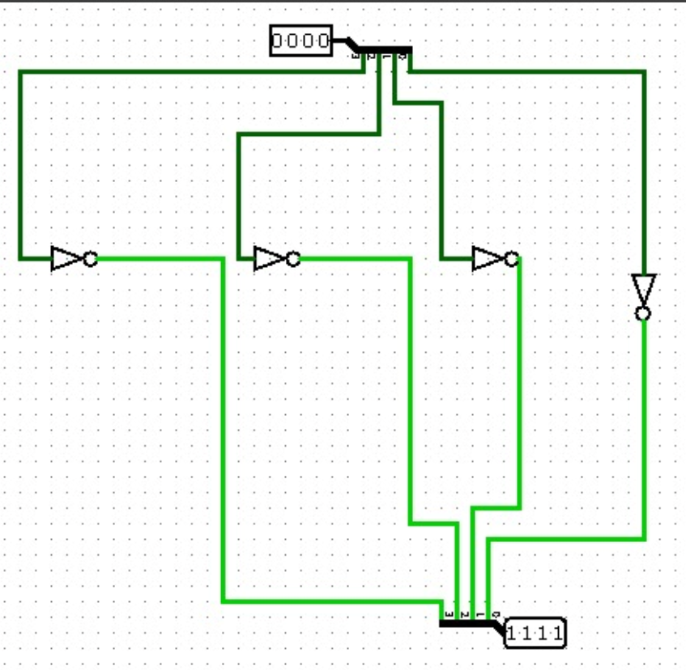
Circuit design

Slide 15
2’s complements Circuit To convert to 2s compliment, "invert each bit, add 1,discard the last carry". So for a 4 bit binary input: Start with 4 inverters, one for each input bit. Each inverted output goes to a 2 bit adder, (an XOR paralleled with an AND). The carry from each lower adder (AND) feeds to the next higher XOR input. The extra 1 is entered at the first XOR spare input. The last adder needs no carry. (so the last adder needs no AND) as last carry discard. 2's complement of "0111" is "1001" 2's complement of "1100" is "0100"

Slide 16
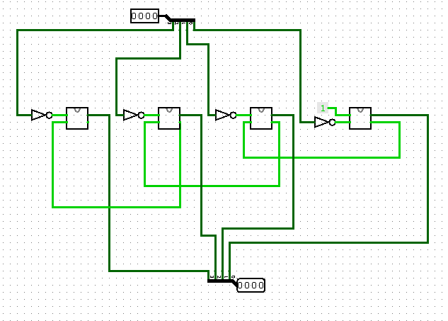
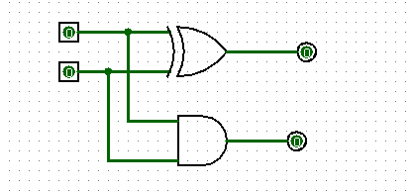
Circuit design

Slide 17
XOR AND XNOR
Toqa sameh

Slide 18
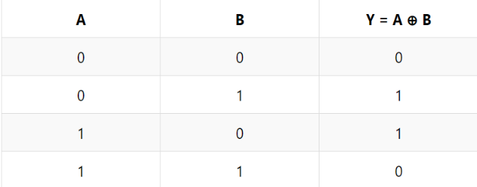
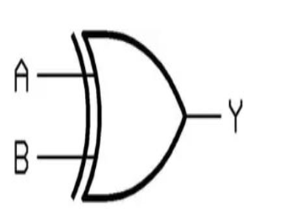
XOR Circuit A XOR gate is a gate that gives a true (1 or HIGH) output when the number of true inputs is odd. An XOR gate is also called exclusive OR gate or XOR.
In a two-input XOR gate, the output is high or true when two inputs are different.

Slide 19
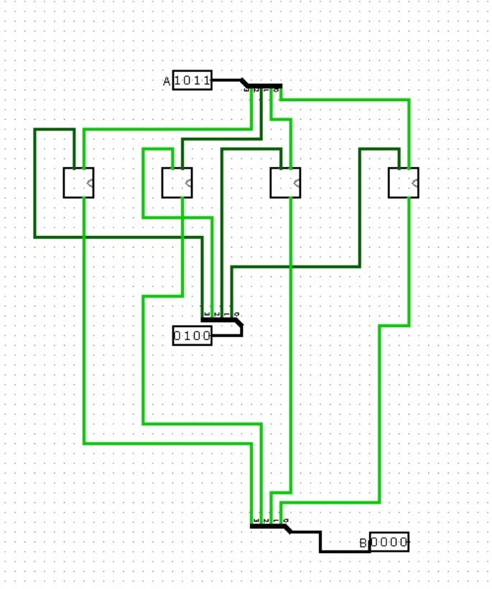
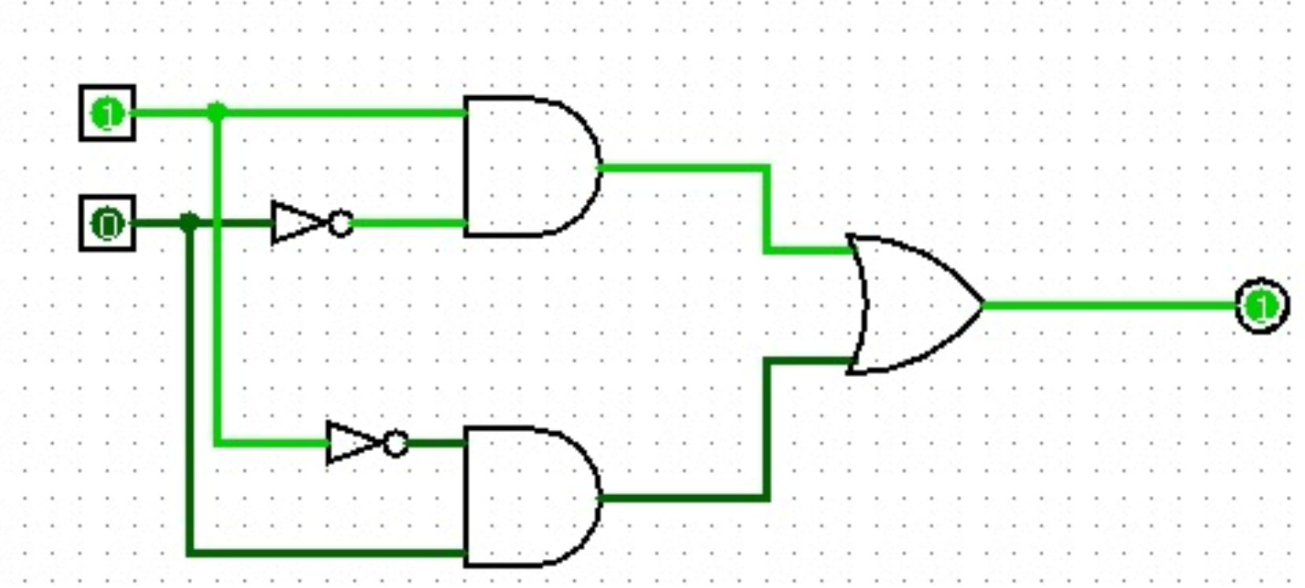
Circuit design

Slide 20
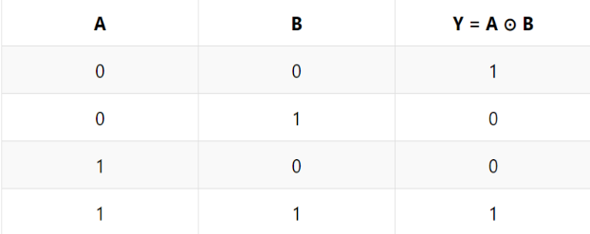
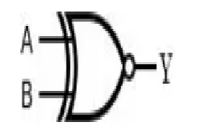
XNOR Circuit An XNOR gate is also called exclusive NOR gate or EXNOR gate. In a two-input XNOR gate, the output is high (logic 1 or true) when two inputs are the same.

Slide 21
MULTIPLIER
Haidy walid

Slide 22
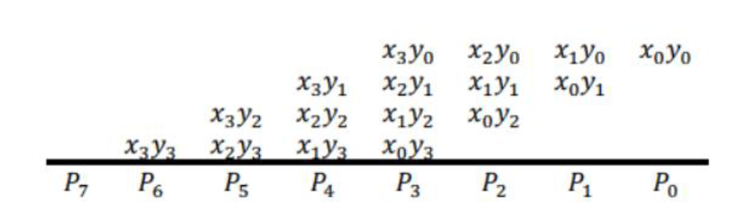
A 4-bit multiplier
is a digital circuit or device that performs the multiplication operation between two 4-bit binary number .
The multiplication of binary numbers is performed in the same way as multiplication of decimal numbers but In the case of a binary operation, we deal with only two digits, i.e. O and 1.
To build a 4-bit multiplier we need 16 AND gates and ( 12 FULL ADDER gates or 3 4-BIT ADDER) To understand how the multiplication operation is work just Let’s take example: X3 X2 X1 X0 * Y3 Y2 Y1 Y0 = P7 P6 P5 P4 P3 P2 P1 P0 Note : X3 X2 X1 X0 Called the multiplicand & Y3 Y2 Y1 Y0 Called the multiplier

Slide 23
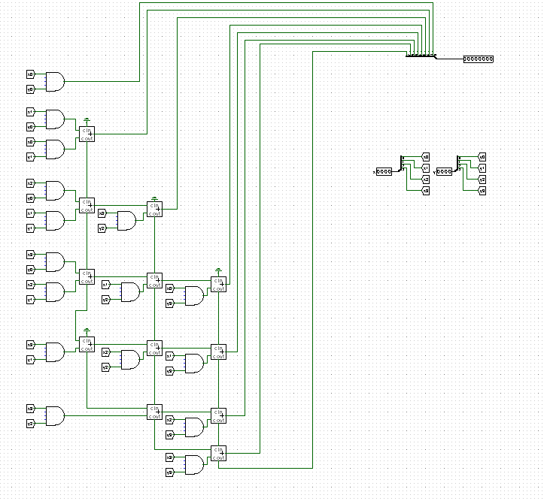
Circuit design

Slide 24
division
Mariam Reda

Slide 25
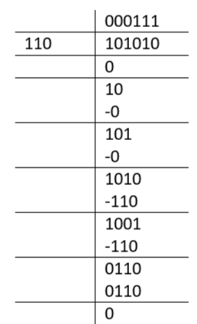
Binary Division:
What is Binary Division?
The binary division operation is similar to the base 10 decimal system, except the base 2.
The division is probably one of the most challenging operations of the basic arithmetic operations.
There are different ways to solve division problems using binary operations.
Long division is one of them and the easiest and the most efficient way.
Before designing the circuit, we will show an example for long division:
Four Steps to Binary Division:
Likewise, decimal division binary division also carries out four steps for the division of numbers.
comparison: First take the leftmost digit of the dividend and compare it
with divisor depending on This comparison , we will get quotient.
Multiplication: Once we have found the quotient we use it
to multiply the divisor to obtain a product.
Subtraction: Having calculated the product in the previous step,
we subtract that from the working dividend to calculate a remainder.
Bring Down: The final step is then to bring down the next digit in our original dividend,
combine it with the remainder in the previous step and form a new working dividend. At this point, the process is repeated.

Slide 26
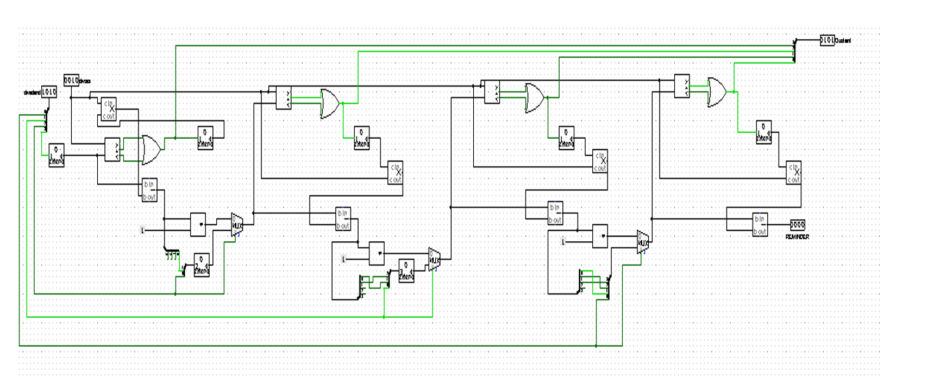
Through the previous explanation of long division, we were able to do this division circuit:

Slide 27
Shifting left
Bassant ehab

Slide 28

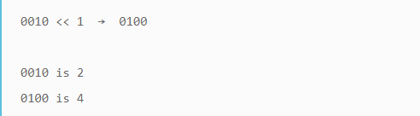
Shifting left :
In this circuit ,
we used 4 bits,in each block there are two and gates and their output enter to other or gate ,the left “and gate” in all the blocks has always low input so that the output from the or gate that takes inputs from the outputs of the two and gates always depend on the right and gate,the right and gate one of its input is high the other input in the right and gate is the next bit ,so the output in each block depends on the second input bit to the right and gate in each block
In the right most block we used ground in the right and gate as in shifting left ,the leftmost bits are always set to zero

Slide 29
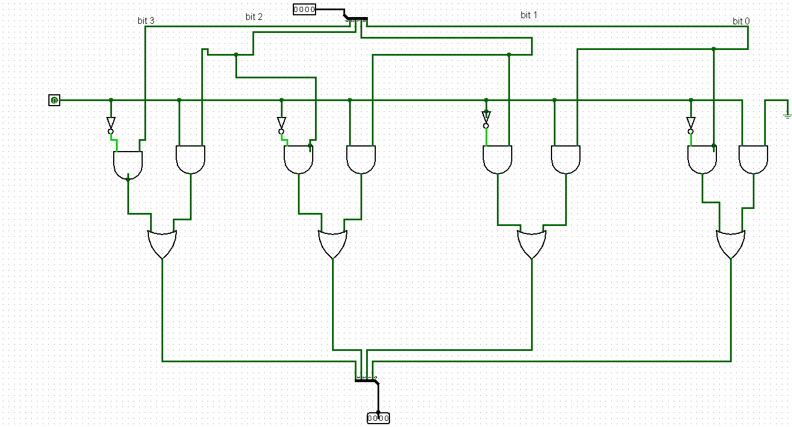
Circuit design

Slide 30
Thank you

